Slide 1

6th Grade Accelerated Math
Unit 5, Lesson 6 Using Two- and Three-Column Tables of Equivalent Ratios Volume 1, pg. 198

Slide 2


Benchmarks
MA.6.AR.3.3
Extend previous understanding of fractions and numerical patterns to generate or complete a two- or three-column table to display equivalent part-to-part ratios and part-to-part-to-whole ratios.
MA.6.AR.3.5
Solve mathematical and real-world problems involving ratios, rates, and unit rates, including comparisons, mixtures, ratios of lengths, and conversions within the same measurement system.
volume 1, pg. 198

Slide 3
Integrated Mathematical Thinking and Reasoning Standards
MA.K12.MTR.5.1 Use patterns and structure to help understand and connect mathematical concepts.
MA.K12.MTR.7.1 Apply mathematics to real-world contexts.
volume 1, pg. 198

Slide 4

Learning Targets
I can use two- and three-column tables to display equivalent ratios.
I can solve problems using two- and three-column tables of equivalent ratios.
volume 1, pg. 198

Slide 5

Warm-Up
volume 1, pg. 198

Slide 6
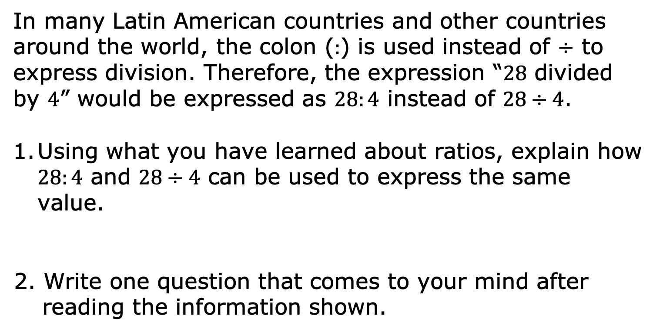
5.6.1 Warm-Up: Different Ways of Expressing Division
In many Latin American countries and other countries around the world, the colon ($:$) is used instead of $÷$ to express division. Therefore, the expression “$28$ divided by $4$” would be expressed as $28:4$ instead of $28÷4$.
Using what you have learned about ratios, explain how $28:4$ and $28÷4$ can be used to express the same value.
2. Write one question that comes to your mind after reading the information shown.
volume 1, pg. 198

Slide 7

Exploration
volume 1, pg. 199

Slide 8

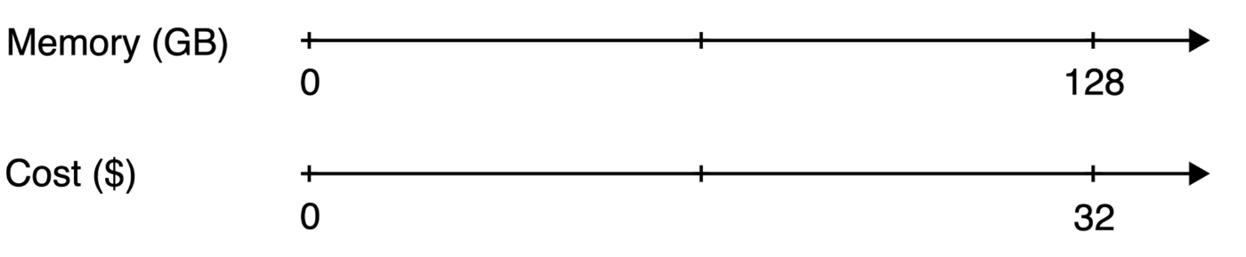
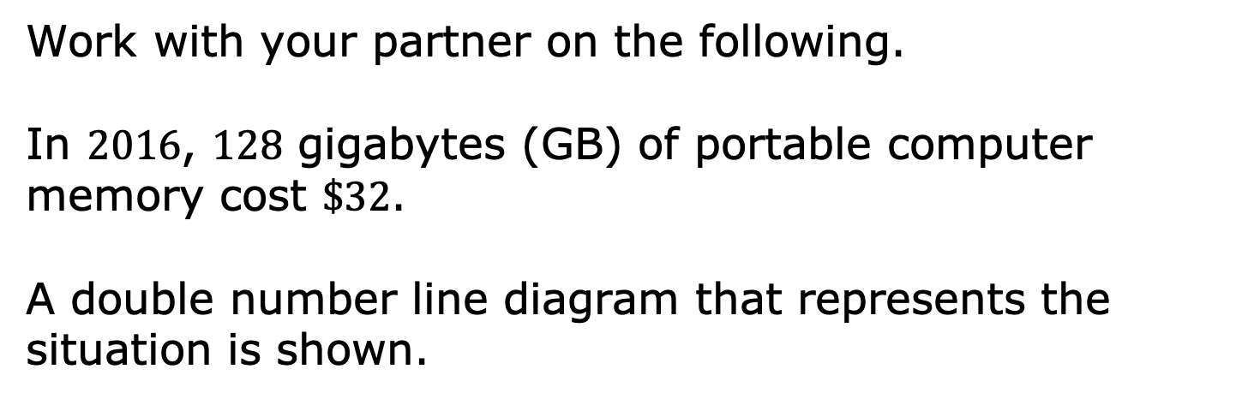
5.6.2 Exploration: Double Number Lines Versus Two-Column Tables
Work with your partner on the following.
In $2016$, $128$ gigabytes (GB) of portable computer memory cost $\$32$.
A double number line diagram that represents the situation is shown.
volume 1, pg. 199

Slide 9
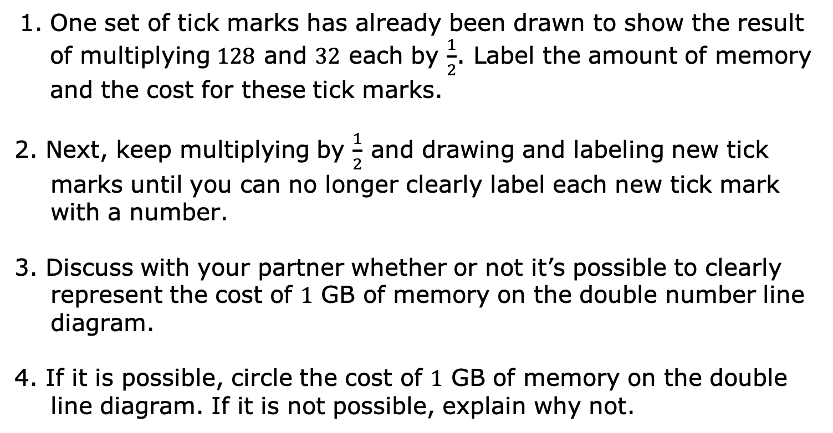
One set of tick marks has already been drawn to show the result of multiplying $128$ and $32$ each by $\frac{1}{2}$. Label the amount of memory and the cost for these tick marks.
2. Next, keep multiplying by $\frac{1}{2}$ and drawing and labeling new tick marks until you can no longer clearly label each new tick mark with a number.
3. Discuss with your partner whether or not it’s possible to clearly represent the cost of $1$ GB of memory on the double number line diagram.
4. If it is possible, circle the cost of $1$ GB of memory on the double line diagram. If it is not possible, explain why not.
volume 1, pg. 199

Slide 10
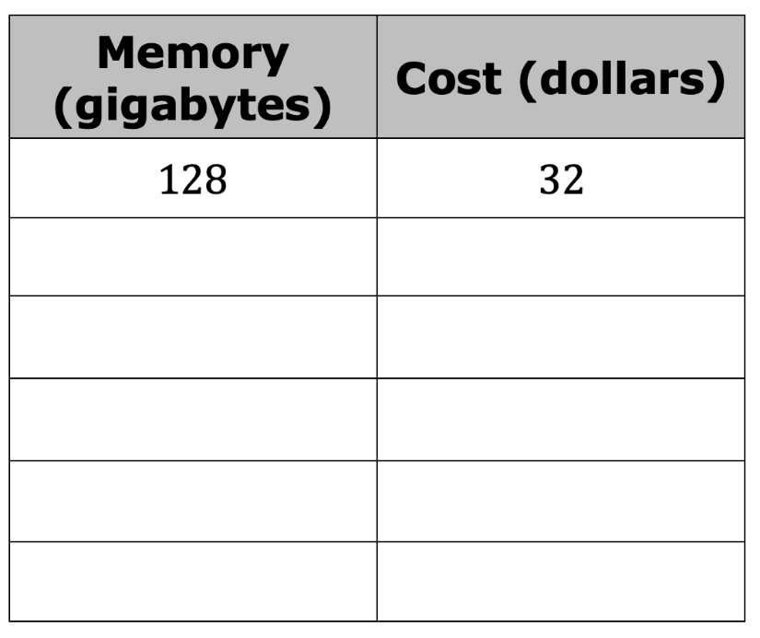
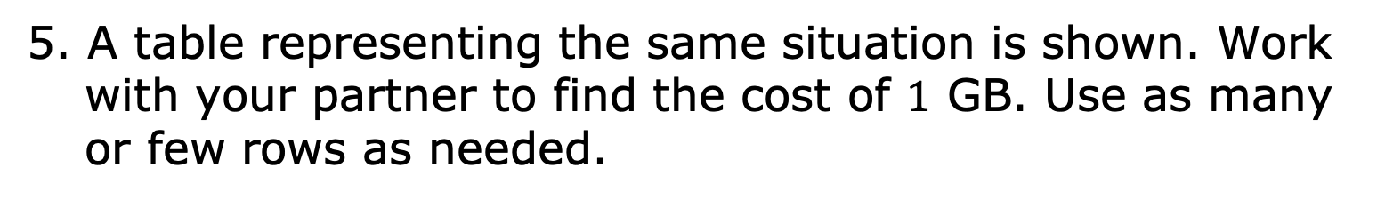
5. A table representing the same situation is shown. Work with your partner to find the cost of $1$ GB. Use as many or few rows as needed.
volume 1, pg. 199

Slide 11
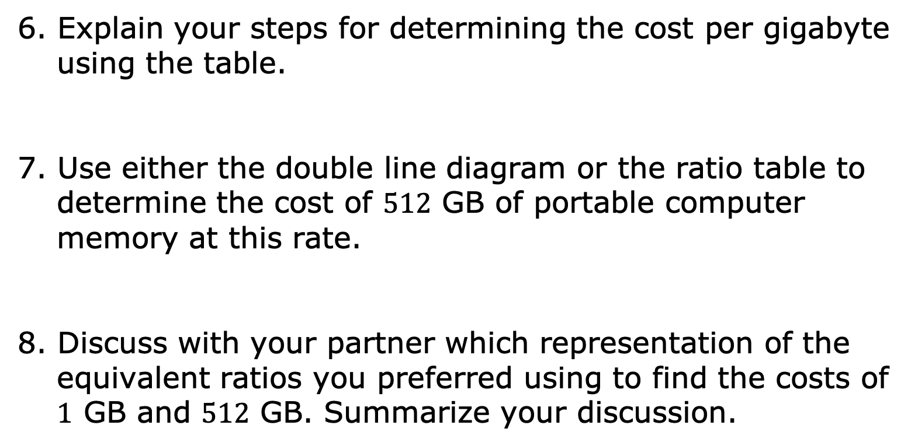
6. Explain your steps for determining the cost per gigabyte using the table.
7. Use either the double line diagram or the ratio table to determine the cost of $512$ GB of portable computer memory at this rate.
8. Discuss with your partner which representation of the equivalent ratios you preferred using to find the costs of $1$ GB and $512$ GB. Summarize your discussion.
volume 1, pg. 199

Slide 12

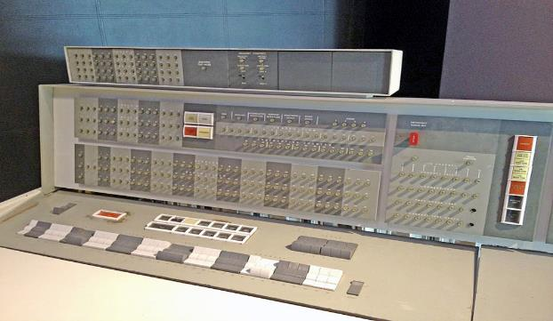
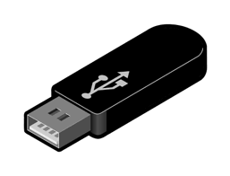
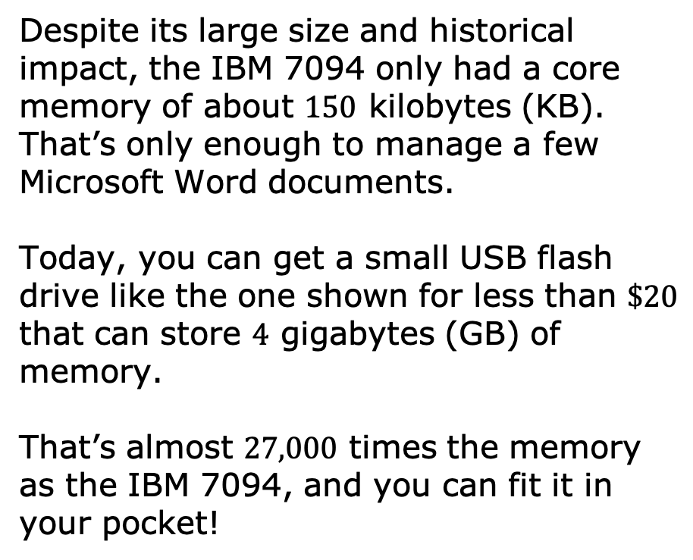
The IBM 7094 was regarded as one of the most powerful advanced mainframe computers in the early 1960s. NASA and the Air Force used it in the Gemini and Apollo space programs.
Despite its large size and historical impact, the IBM 7094 only had a core memory of about $150$ kilobytes (KB). That’s only enough to manage a few Microsoft Word documents.
Today, you can get a small USB flash drive like the one shown for less than $\$20$ that can store $4$ gigabytes (GB) of memory.
That’s almost $27,000$ times the memory as the IBM 7094, and you can fit it in your pocket!
volume 1, pg. 200

Slide 13

Guided Instruction
volume 1, pg. 200

Slide 14
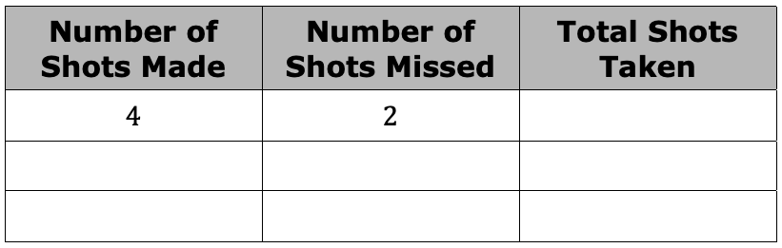
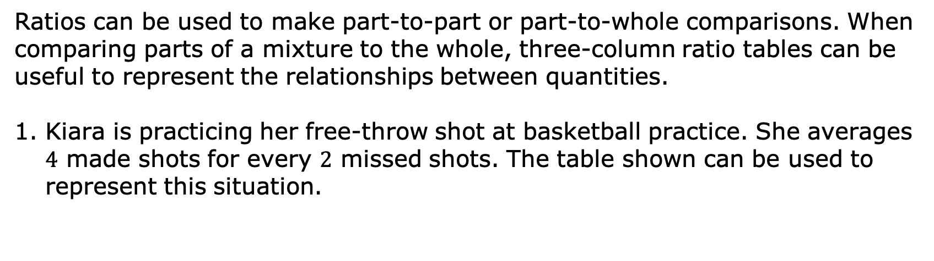
5.6.3 Guided Instruction: Using Three-Column Ratio Tables
Ratios can be used to make part-to-part or part-to-whole comparisons. When comparing parts of a mixture to the whole, three-column ratio tables can be useful to represent the relationships between quantities.
Kiara is practicing her free-throw shot at basketball practice. She averages $4$ made shots for every $2$ missed shots. The table shown can be used to represent this situation.
volume 1, pg. 200

Slide 15
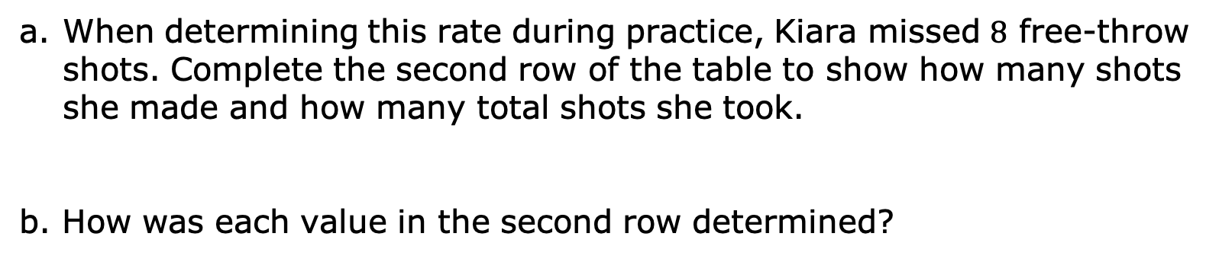
When determining this rate during practice, Kiara missed $8$ free-throw shots. Complete the second row of the table to show how many shots she made and how many total shots she took.
b. How was each value in the second row determined?
volume 1, pg. 200

Slide 16
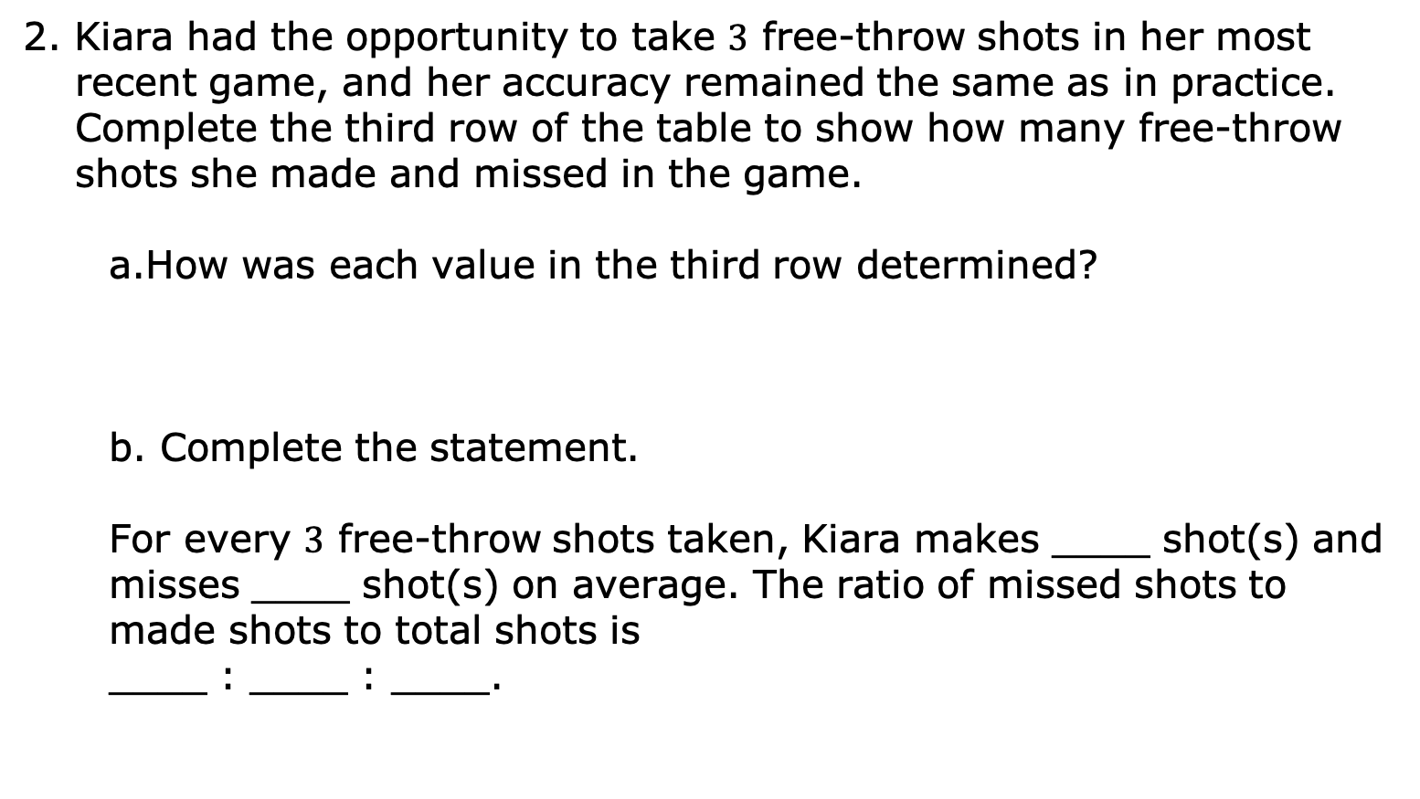
2. Kiara had the opportunity to take $3$ free-throw shots in her most recent game, and her accuracy remained the same as in practice. Complete the third row of the table to show how many free-throw shots she made and missed in the game.
How was each value in the third row determined?
b. Complete the statement.
For every $3$ free-throw shots taken, Kiara makes ____ shot(s) and misses ____ shot(s) on average. The ratio of missed shots to made shots to total shots is
____ : ____ : ____.
volume 1, pg. 201

Slide 17
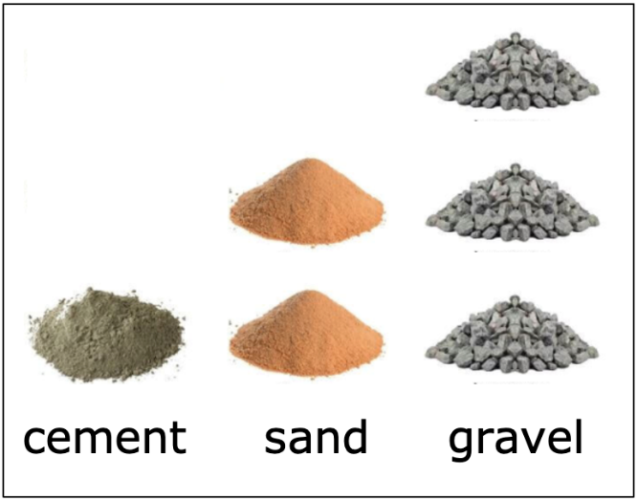
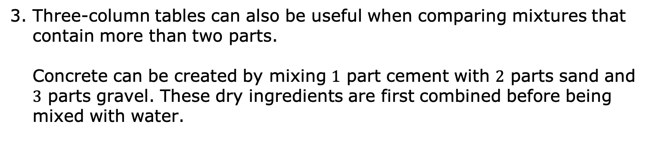
3. Three-column tables can also be useful when comparing mixtures that contain more than two parts.
Concrete can be created by mixing $1$ part cement with $2$ parts sand and $3$ parts gravel. These dry ingredients are first combined before being mixed with water.
volume 1, pg. 201

Slide 18
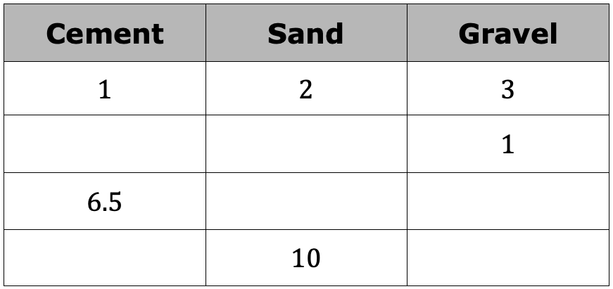
Complete the table to determine equivalent mixtures of concrete. Show how the values in each row are determined using arrows and by indicating the factor used.
b. Marc uses one-gallon buckets to measure out the quantities needed in his concrete mixture. How many gallons of dry mix will he have in one batch of concrete?
volume 1, pg. 201

Slide 19

Guided Practice
volume 1, pg. 202

Slide 20

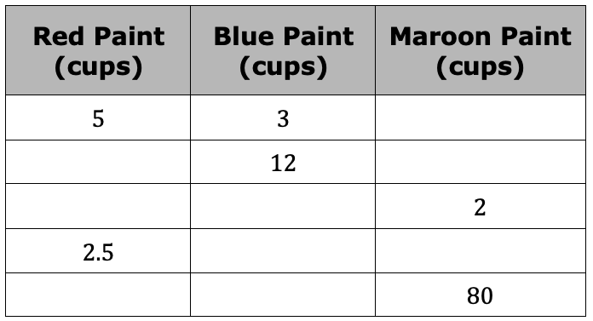
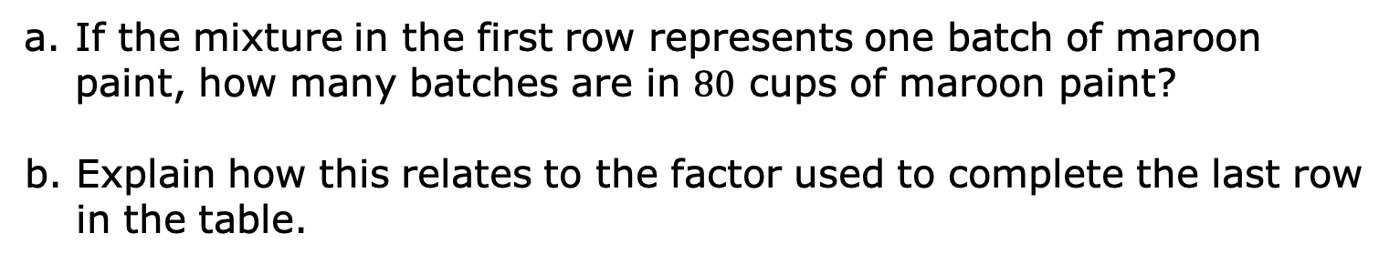
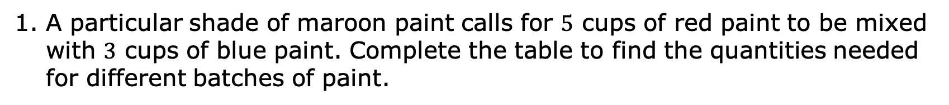
5.6.4 Guided Practice: Using Two- and Three Column Ratio Tables
A particular shade of maroon paint calls for $5$ cups of red paint to be mixed with $3$ cups of blue paint. Complete the table to find the quantities needed for different batches of paint.
If the mixture in the first row represents one batch of maroon paint, how many batches are in $80$ cups of maroon paint?
b. Explain how this relates to the factor used to complete the last row in the table.
volume 1, pg. 202

Slide 21
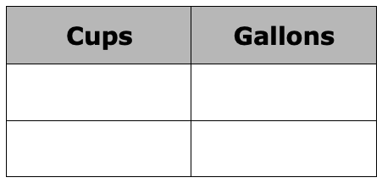
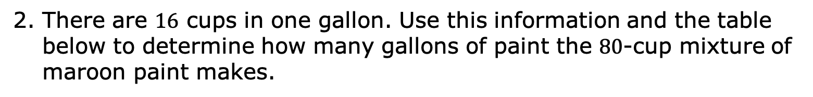
2. There are $16$ cups in one gallon. Use this information and the table below to determine how many gallons of paint the $80$-cup mixture of maroon paint makes.
volume 1, pg. 202

Slide 22
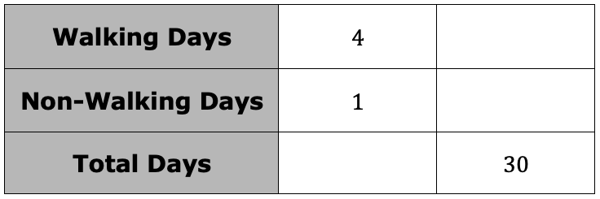

3. In April, Kyla went for a walk on $4$ days for every $1$ day that she did not walk. There are $30$ days in April. Use this information to complete the ratio table.
Complete the statement.
Throughout the year, Kyla continued walking $4$ days for every $1$ day that she did not walk. Based on this, in November, Kyla walked____ of the $30$ days.
volume 1, pg. 202

Slide 23

Wrap-Up
volume 1, pg. 203

Slide 24
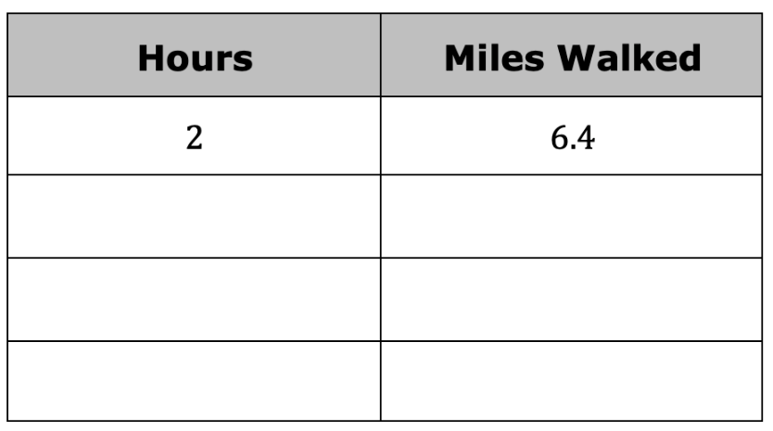
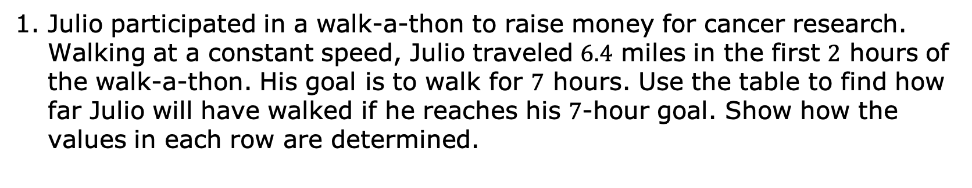
5.6.5 Wrap-Up: Ticket Out the Door
Julio participated in a walk-a-thon to raise money for cancer research. Walking at a constant speed, Julio traveled $6.4$ miles in the first $2$ hours of the walk-a-thon. His goal is to walk for $7$ hours. Use the table to find how far Julio will have walked if he reaches his $7$-hour goal. Show how the values in each row are determined.
volume 1, pg. 203

